Slide 1
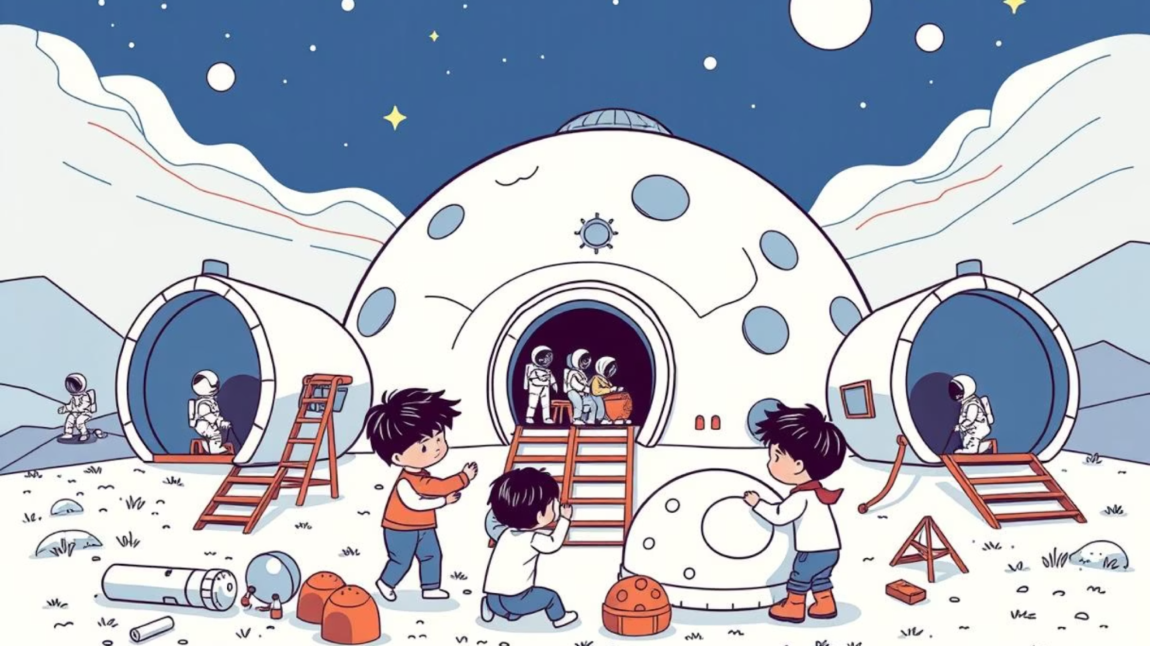
Lunar Base
SeeSaw
Notes:
https://edu.delightex.com/YZD-EFM

Slide 2
Mild Challenge: Your First Steps on the Moon
Mission: Build a safe and functional home for one astronaut.
What You Need:
1 main habitat dome
1 airlock door
1 character + animation
Success Looks Like: A secure living area with a clear entrance.
Hot Challenge: Expanding Your Lunar Outpost
Mission: Create a base with different areas for living and working.
What You Need:
2 domes (e.g., living & lab)
Tube connectors
2 airlock doors
2-3 characters placed around
Success Looks Like: Connected areas, multiple entry points, and characters doing different tasks.
Spicy Challenge
Mission: Design a large, advanced lunar city with many specialized areas.
What you need to build:
At least three domes, each with a different color and function.
A detailed network of tubes connecting the domes.
Many airlocks placed in smart locations.
Multiple characters with unique jobs.
Bonus: Characters that follow custom patrol routes.
Goal: Create an advanced, interactive, and professional-looking lunar city.
Notes:
Top Tip
Might have to remind children how to set Animation - This can be done without code - Right Clight animation

Slide 3

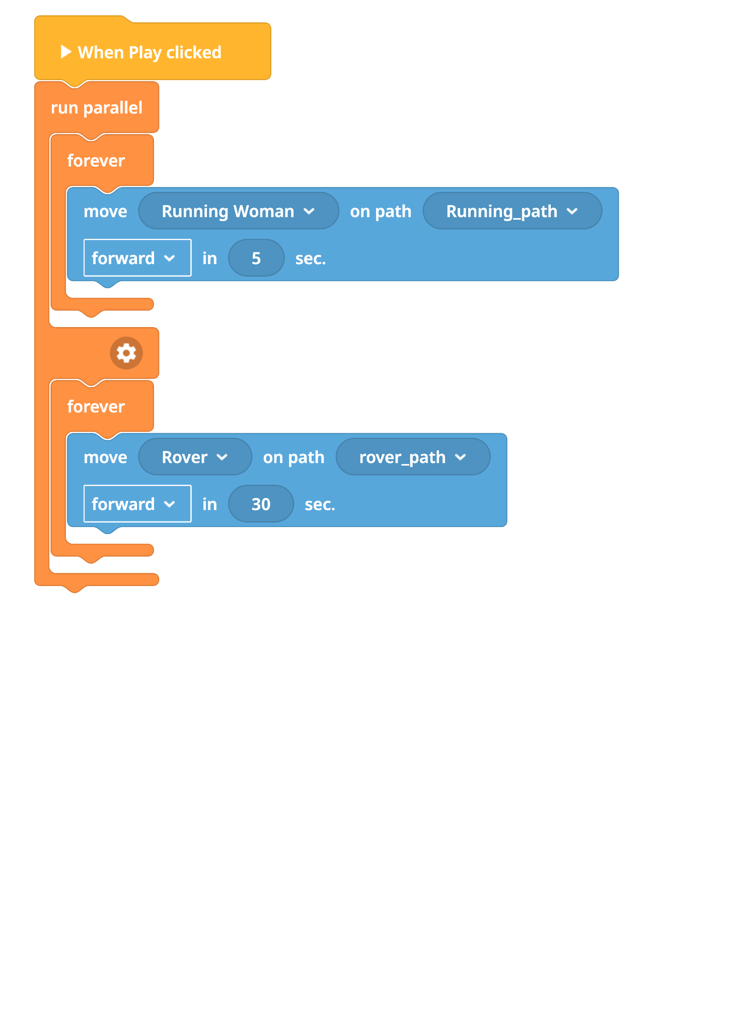
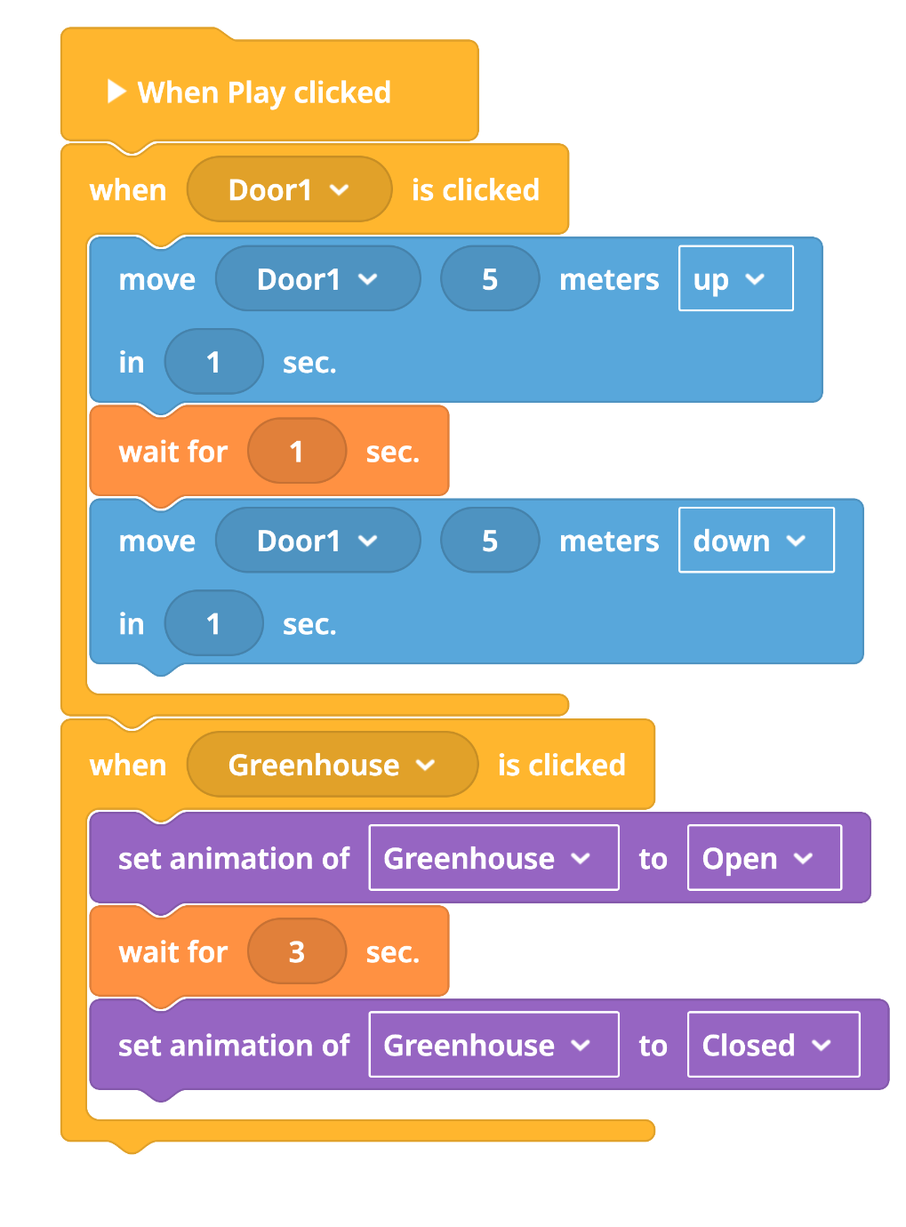
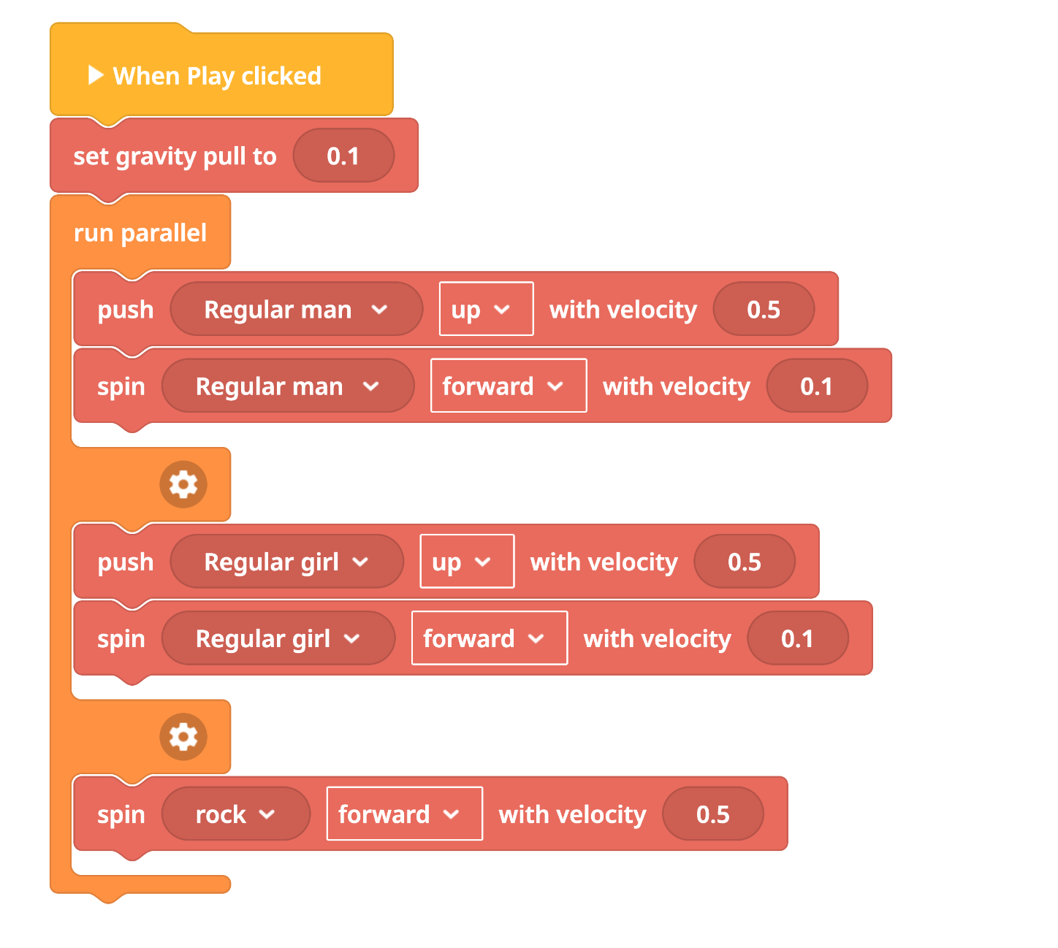

Slide 4
Lesson Objectives
By the end of this lesson, you will:
Have Completed your Quizizz
Have Added your Link to SeeSaw
Completed Self Reflection
Notes:
https://edu.delightex.com/YZD-EFM
Understand the components and structure of a completed space base.
Design and create your unique base using domes, tubes, and airlocks.
Add characters and animate their movements within your lunar base design.

Slide 5
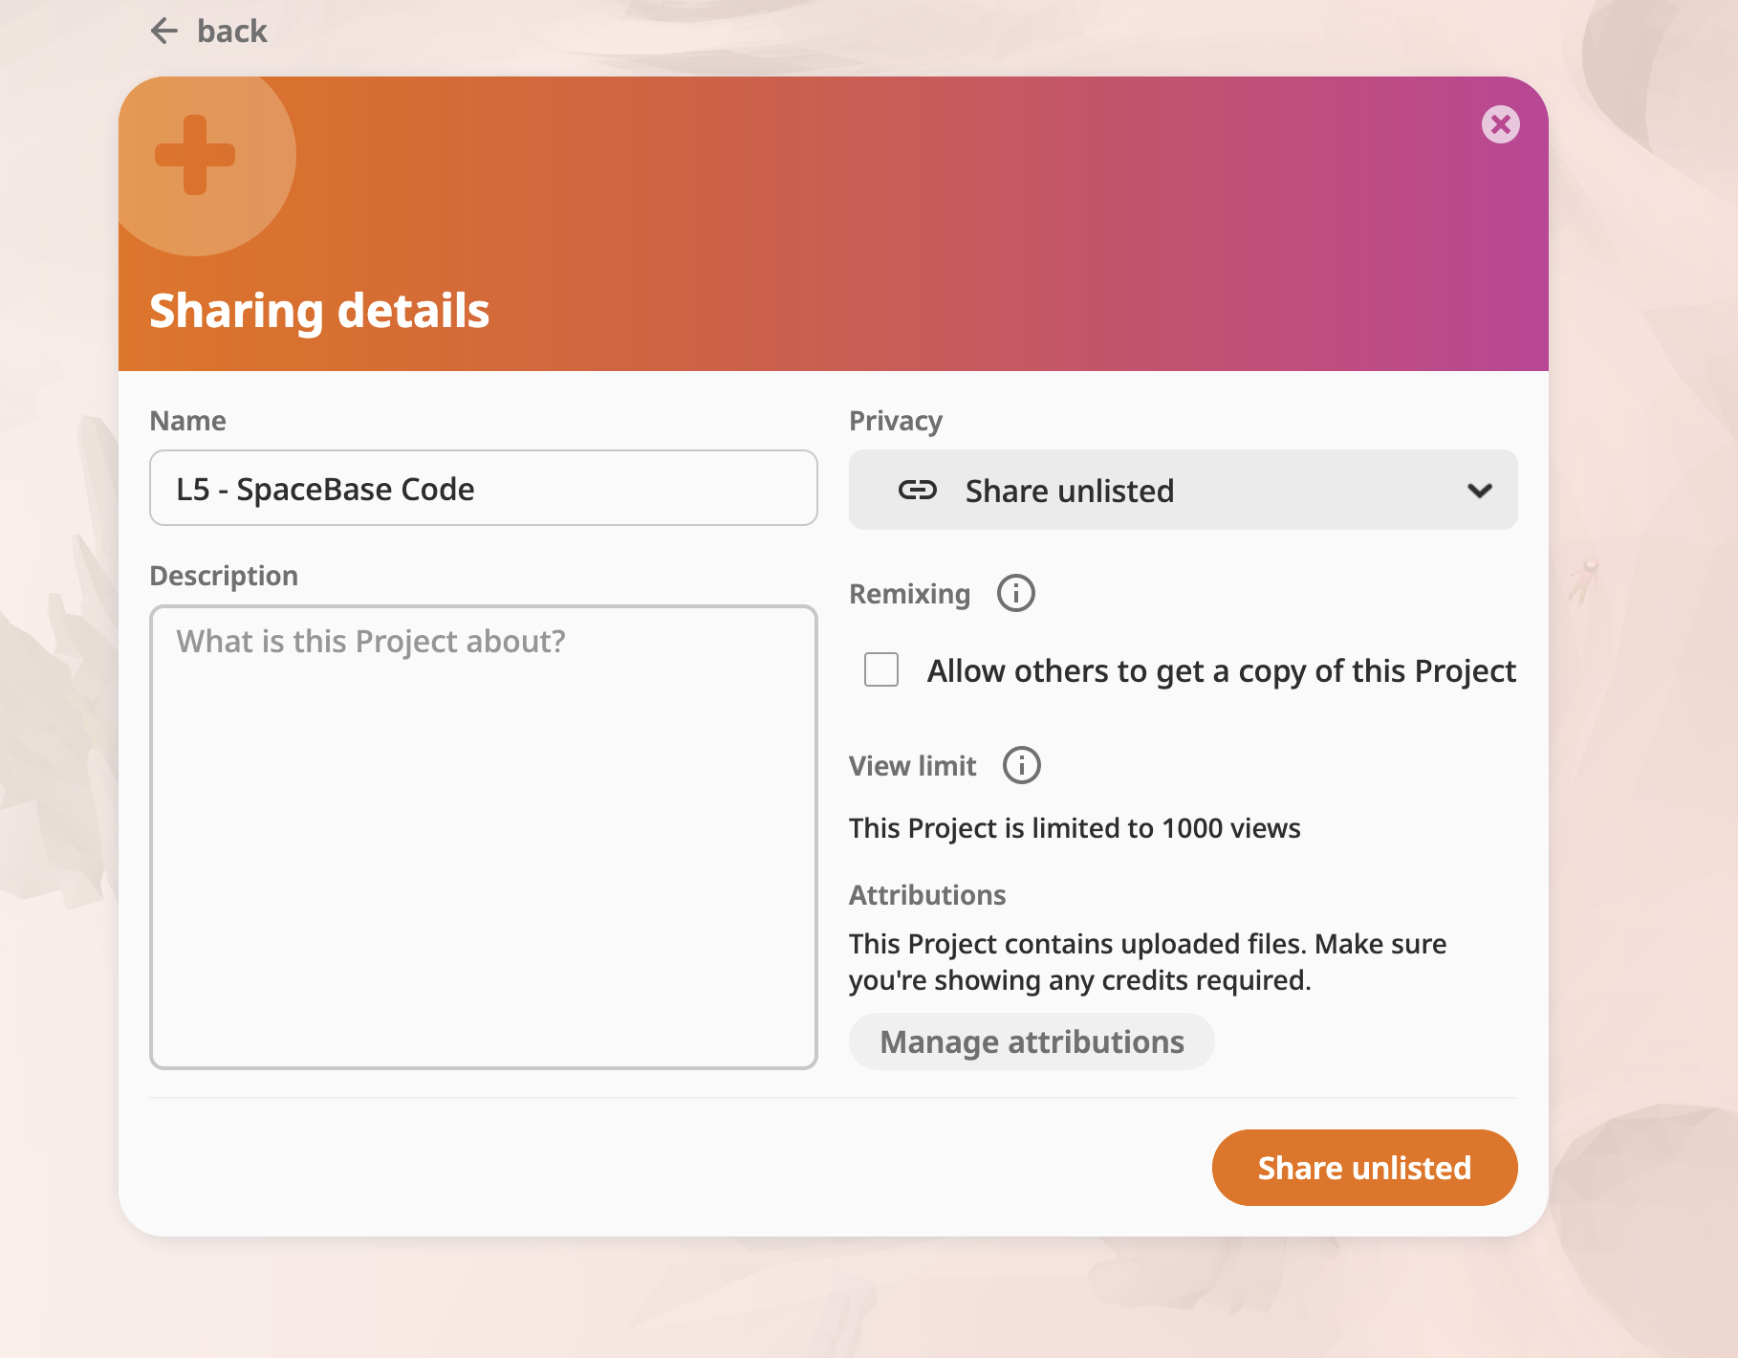
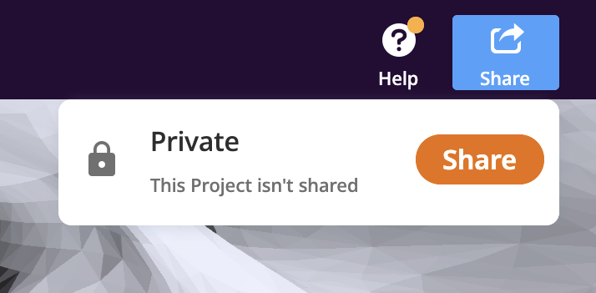
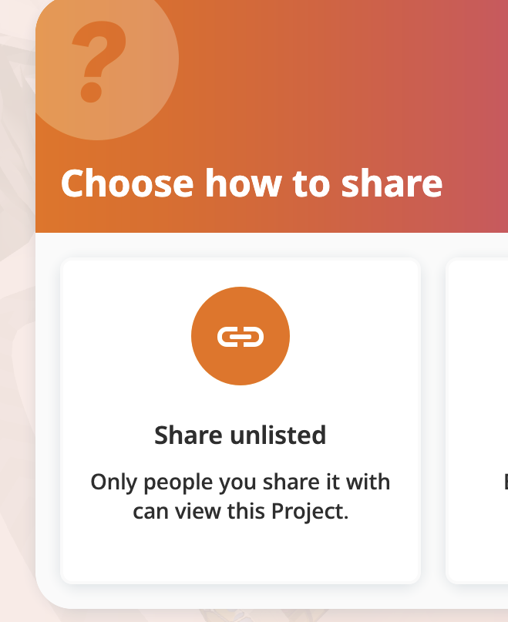
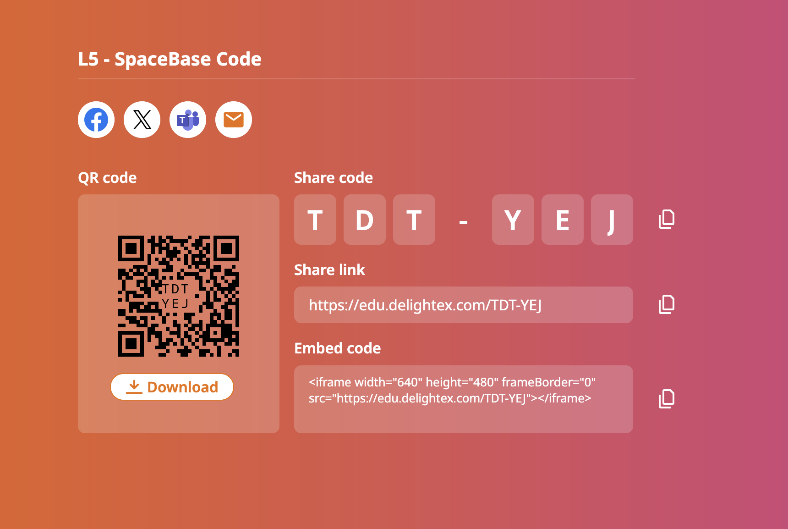
Sharing your project
Notes:
https://edu.delightex.com/YZD-EFM
Understand the components and structure of a completed space base.
Design and create your unique base using domes, tubes, and airlocks.
Add characters and animate their movements within your lunar base design.

Slide 6
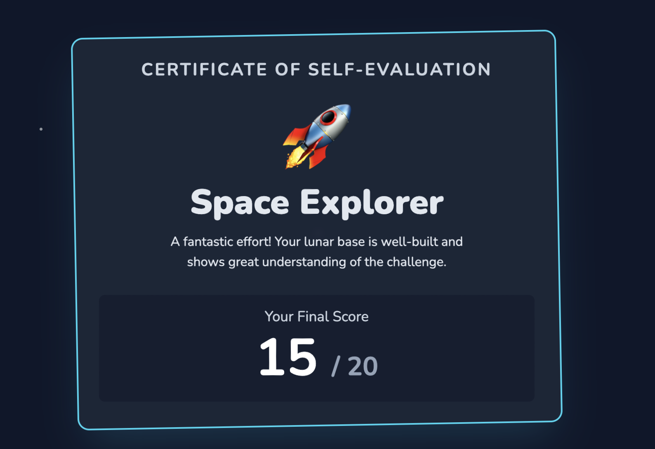
Self Evaluation
Notes:
https://lunar-base-self-assessment-801886913830.us-west1.run.app/

